Slide 1

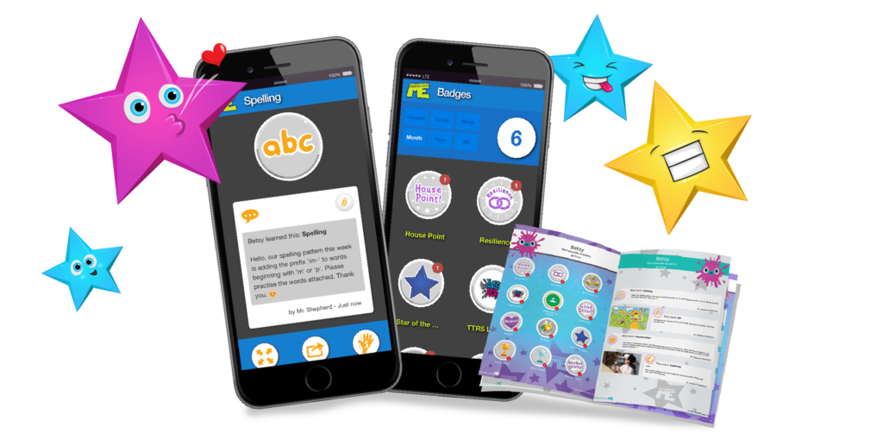
Cherish the moment.
Forever.
Our school is proud to use

Slide 2




Cherish the moment.
Forever.
Get pinged when your child does something marvellous.
Celebrate and support their learning and achievements.
Keep up to date with school messages and home tasks.
Share the app with partners, grandparents and carers.
Send a Hi5 back.
Don’t miss out! It’s free!

Slide 3
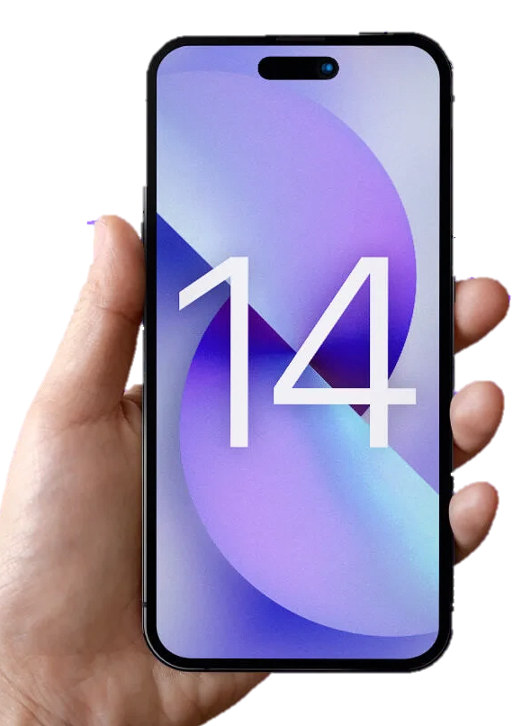
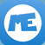

PING!
MarvellousMe for Parents
now
Anna has just done something marvellous! Tap for more.
Get the MarvellousMe for Parents app, or join online at www.marvellousme.com.
Ask the school office for your unique join code and get pinged about the wonderful things your child is doing at school.

