Slide 1

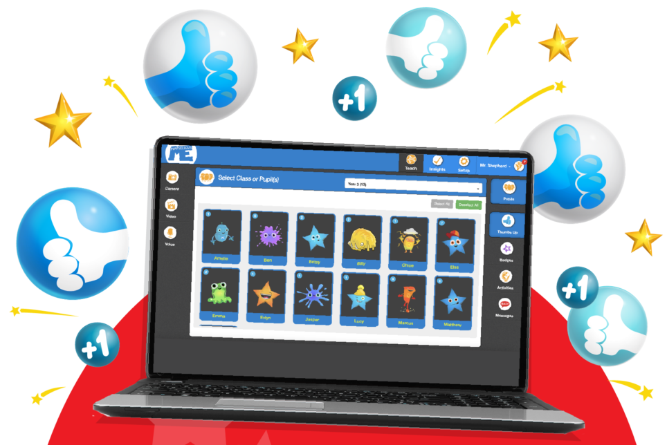
Teacher Tutorial

Slide 2
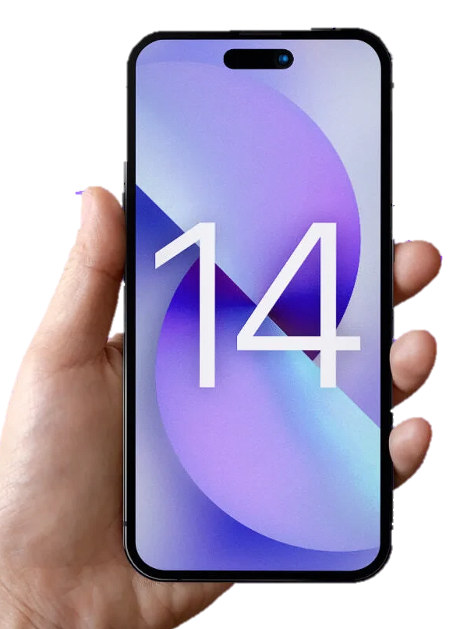

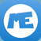

Why are we using MarvellousMe?
MarvellousMe for Parents
now
Anna has just done something marvellous! Tap for more.
PING!
It’s a personalised one-way communications tool to use in class with the children and share great news to engage their parents in real time.
.
Parents cannot message back but can Hi5.
.
Delivers emotionally engaging news to parents about their child’s learning, happiness and progress.
.
Designed as a whole-school system with tools to keep comms fair and consistent.

Slide 3

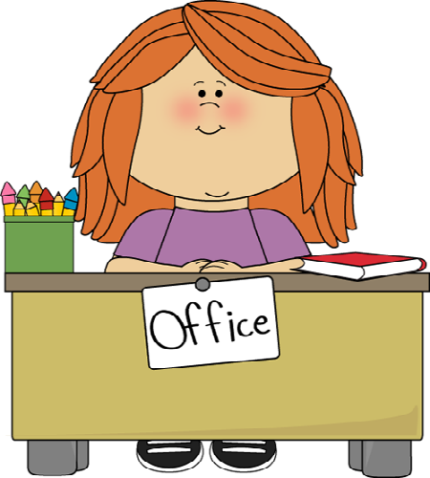
How do school communications make parents feel?
Office-led
Teacher-led
Important and necessary information but is not emotionally engaging for parents.
MarvellousMe makes it easy for teachers to tell parents about their child’s learning and achievements – the news parents want to hear.
Making parents and children smile and enjoy great conversations after school.
Children are happier and do better, and teachers are appreciated and backed up.
School notices, payments, bookings etc. (sent out by email, text, letters, MIS)
App alerts come through in real time with child-specific learning and progress-led news.

Slide 4
MarvellousMe Activities
Sharing learning-led news
EXPECTATION: Send 2 whole-class Activities each week.
Can write the postcard together with the children in a plenary to recap learning.
Can include photos (e.g. of a piece of work by the child) – super proud parents.
Parents receive the notification in real time and message is personalised with the child’s name – emotionally impactful.
TOP TIP - Add a weekly reminder to your diary e.g. Tuesday and Friday mornings.

Slide 5
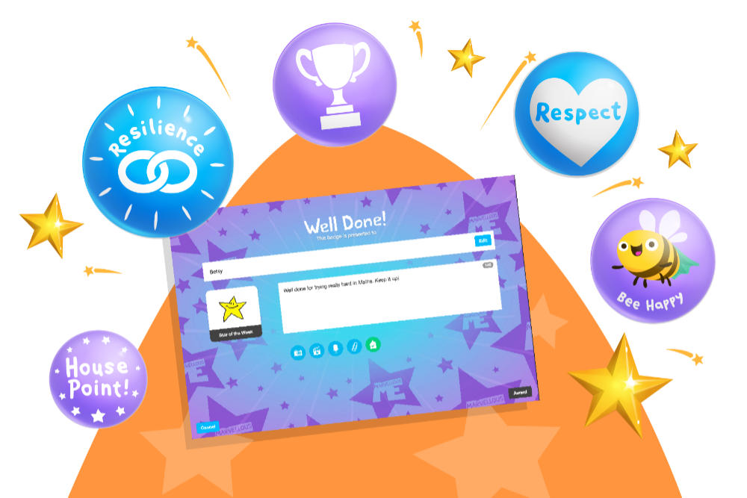
MarvellousMe Badges
Recognising positive behaviours and awards
EXPECTATION: Award each child a minimum of 1 School Badge each fortnight.
Badges are sent to parents instantly so they can feel proud of their child and be ready to great them from school with a “Well Done”.
They can be awarded to individual children, or several at once.
Can attach photos (e.g. of a piece of work by the child).

Slide 6
Our School Badges
The below Badges have been set up to reinforce the learning powers. You will find them at the top of your Badge catalogue, highlighted with a star.
COPY AND PASTE A SCREEN SHOT OF YOUR SCHOOL BADGES FROM THE TEACHER SYSTEM

Slide 7
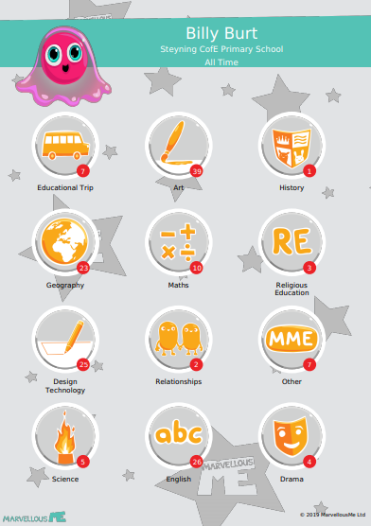
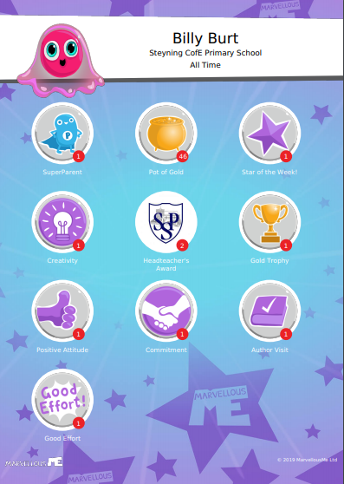
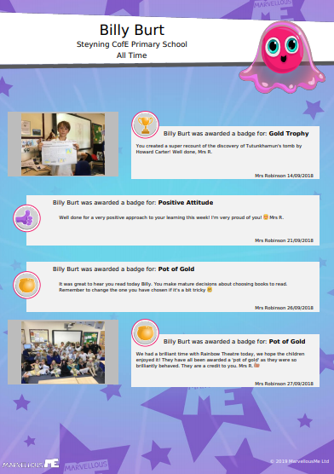
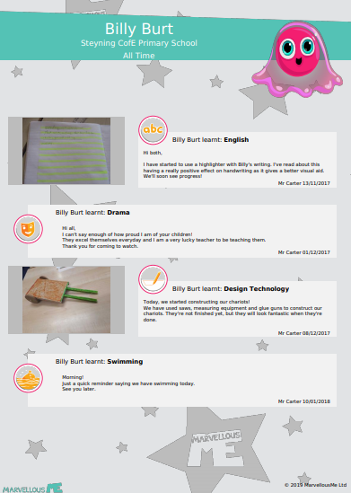
MemoryBook
By regularly awarding Badges and sharing Activities, you are creating a treasured MemoryBook for the parents. These free downloadable PDFs are cherished keepsakes of the child’s time at your school.
Entries are date stamped.
Record of the child’s learning and achievements.
Will include any photos you attached.
Ideal as end of year keepsake but can be created for any time frame.
Accessed in the parent app ‘Settings’ and through the Teacher system’s ‘Insights’.
Won’t include anything sent as a Message. Save these for notices and reminders.

Slide 8


Thumbs Up!
Quick-fire praise in the classroom
EXPECTATION: Use the Thumbs Up tool to award House Points to the children.
We can report these by pupil, class or House at any time.
Parents are not alerted with ‘Thumbs Ups’ but they can see their child’s totals.
Show the number of Thumbs Up points for each child in a Thumbs Up counter.
Can be awarded in values of 1, 5, 10, 15 and 20.
Analyse class and pupil scores in ‘Insights’.
Set an audio ping (tap your name and ‘Counters’).

Slide 9
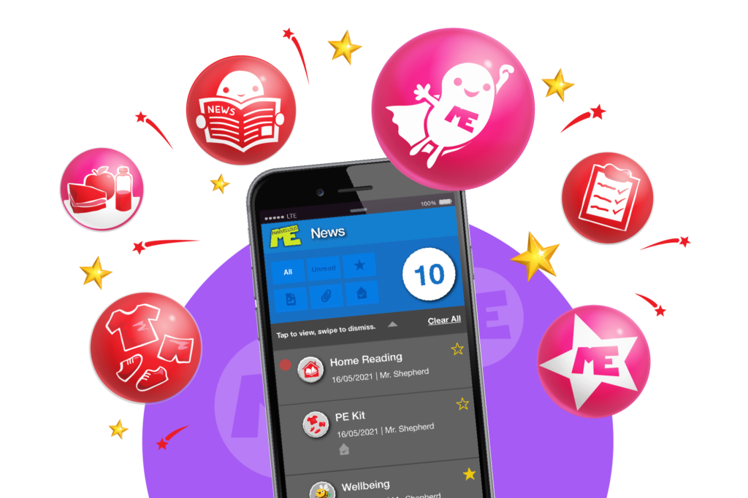
MarvellousMe Messages
Sending general notices and reminders
EXPECTATION: Use where necessary but try to keep content positive.
Send general messages and reminders from the classroom e.g. Bring in PE kit tomorrow, library book reminders, details of school trips.
They are visual, on-point and delivered instantly.
Use where needed but keep language as positive as possible – ensure MarvellousMe remains a positive experience for parents.

Slide 10


Keeping Consistent
Put your ‘parent’ hat on
Remember to regularly share news with ALL parents. Any inconsistencies are quickly picked up by parents.
Feelgood!
The happiest teacher-to-parent
app in the world.
Tools to help you keep things fair and consistent.
  Counters
  Reports in the ‘Insights’ section of your Teacher account
  Weekly snapshot emails
Don’t forget that all Badges and Activities are automatically saved in the child’s downloadable Memory Book.

Slide 11
Getting Parents
Joined Up!
Even if parents are slow to join, they will catch up with all the missed news so it’s never too late.
View which parents are/are not signed up in the ‘Setup’ tab on your Teacher app. Teachers can print join code letters or ask office to.
Use the translations of the join code letter for any parents with EAL.
Occasionally send ‘Thank You’ Badges for the parents to encourage ongoing support with their child’s learning.
You can give the same MarvellousMe join code to separated parents and carers, and they can share the app with people they trust.
Feelgood!
The happiest teacher-to-parent
app in the world.

Slide 12
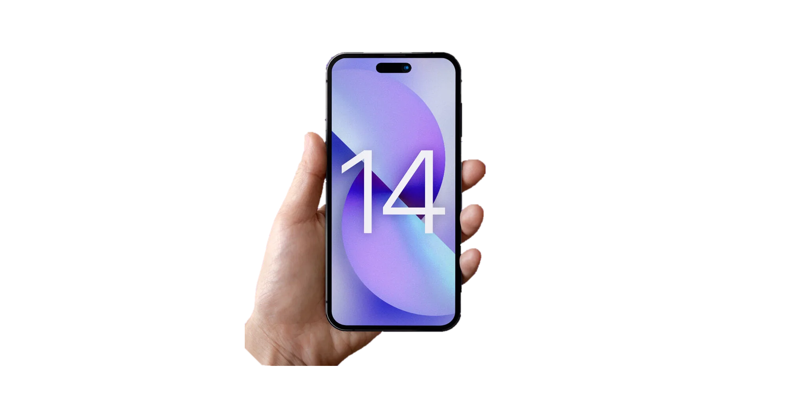
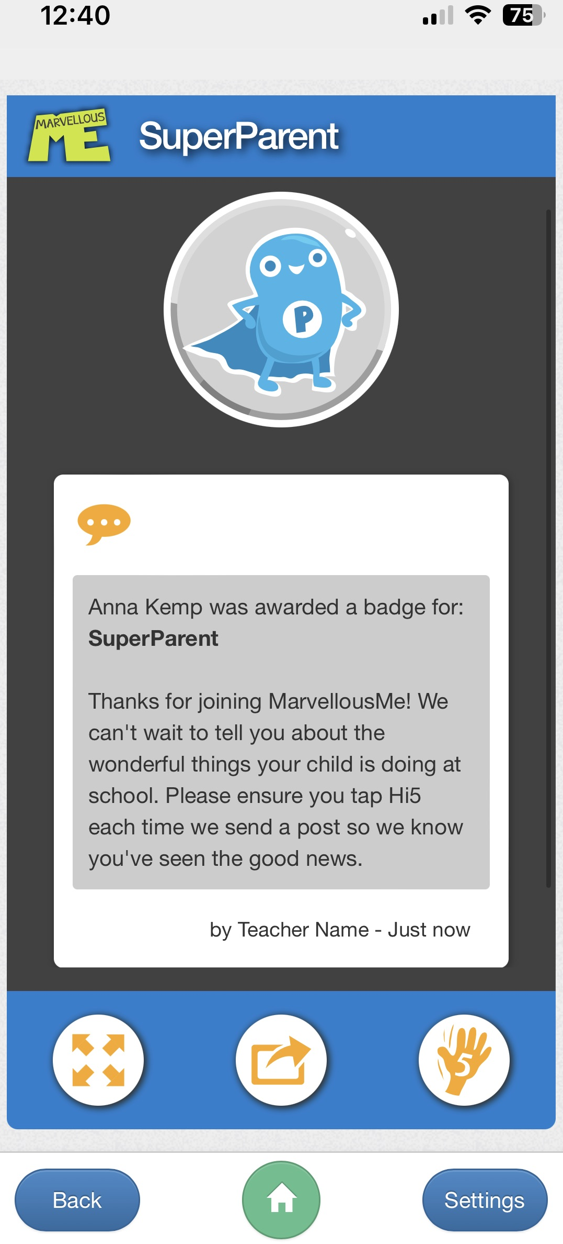

A great way to introduce MarvellousMe
is to send out a
SuperParent
Badge
to all the parents to say thank you for joining and encouraging them to Hi5 every MarvellousMe they read.

Slide 13
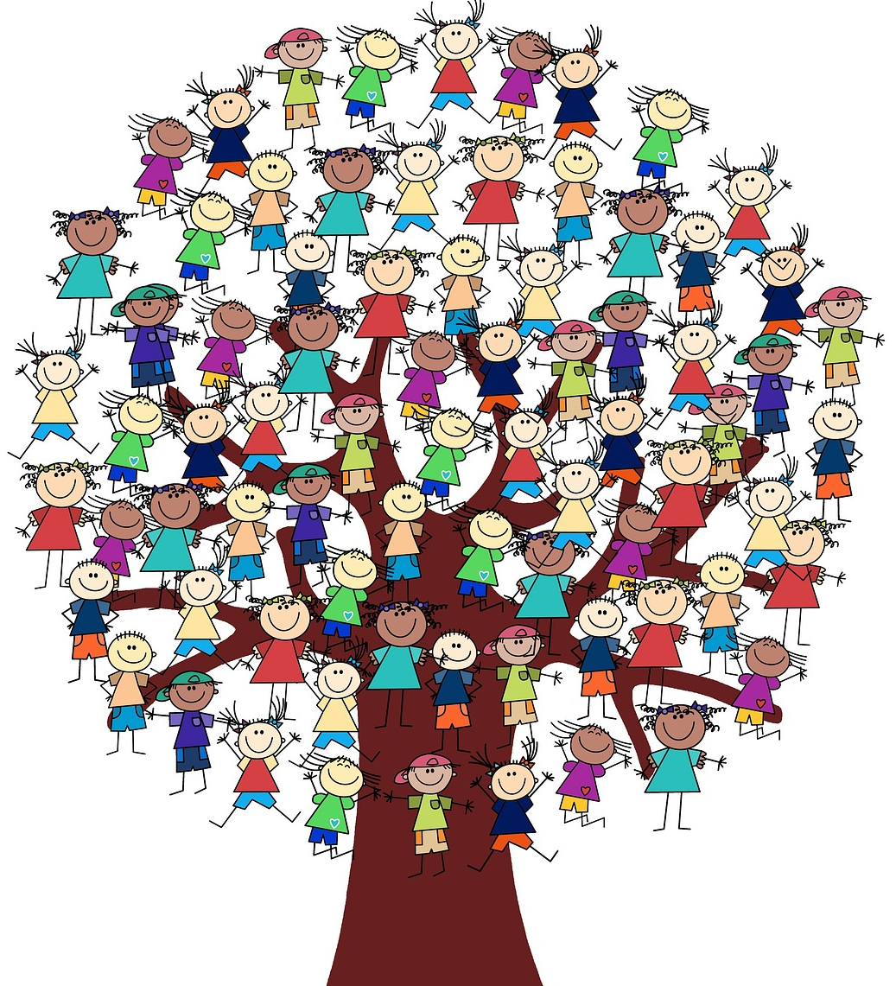
Parents slow to join will still be able to see all the wonderful news you have been sharing with them, so please include everyone from the start.

Slide 14
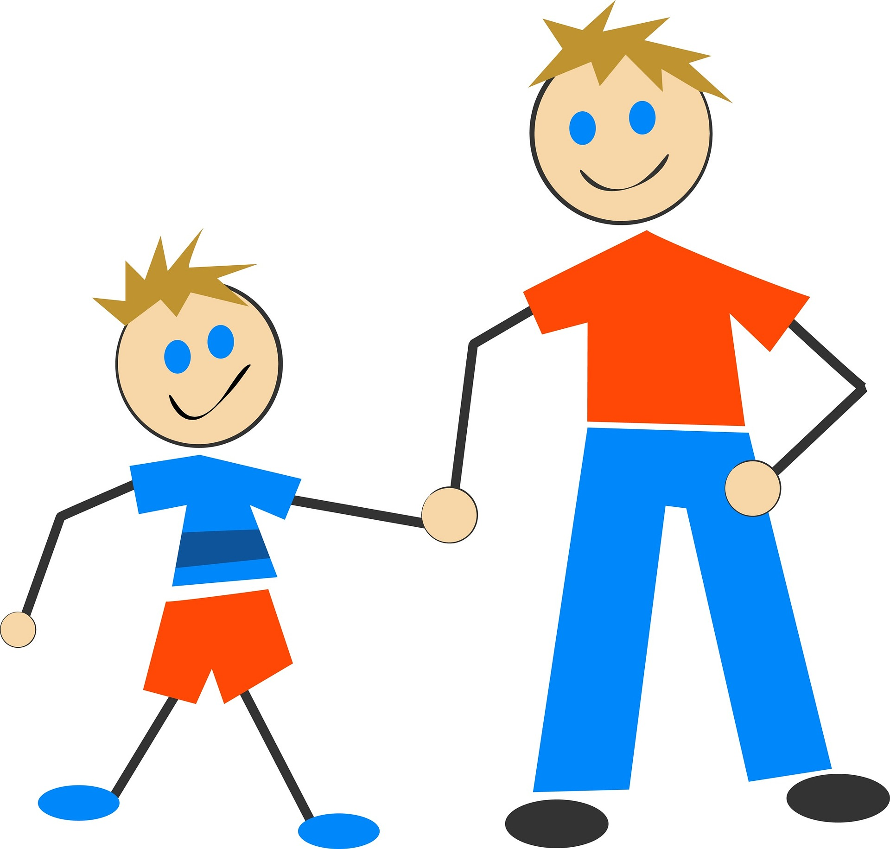
Don’t under-estimate
pester power!
Using MarvellousMe with the children in the classroom will mean they naturally want to make sure their parents are hearing the good news.

Slide 15
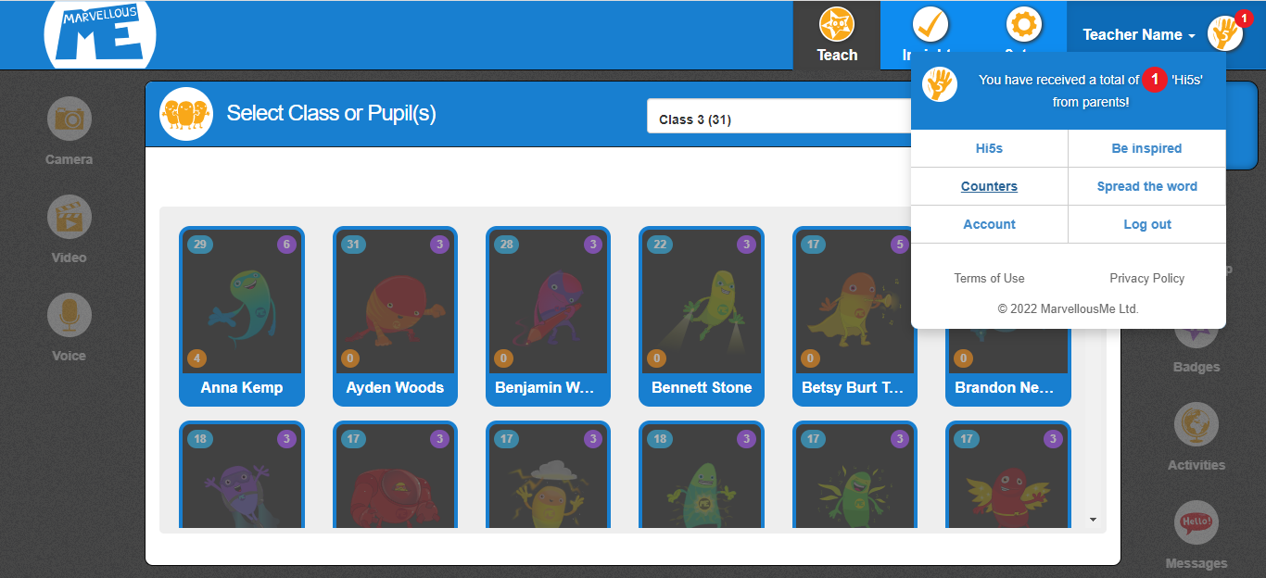

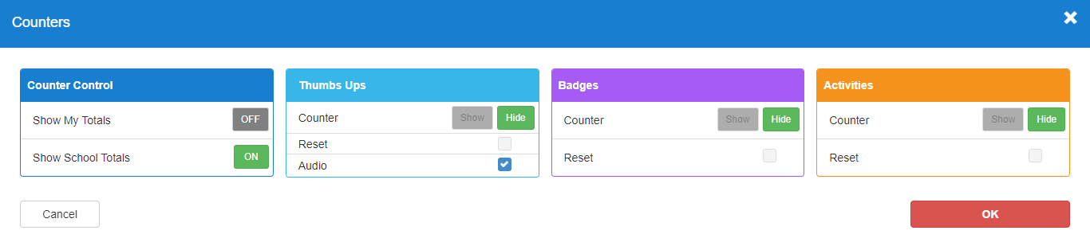
Counters
1
2
3
4

Slide 16
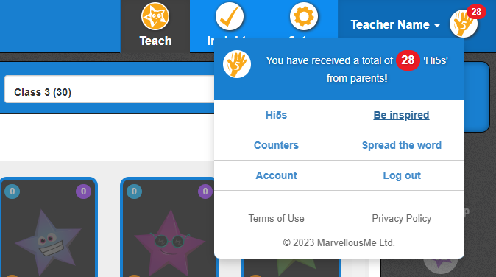




Need more help?
Click on your name in the top-right corner of your Teacher account.
Select ‘Be Inspired’ to access the teacher training portal.
Feelgood!
The happiest teacher-to-parent
app in the world.
Social Media
Find and follow MarvellousMe on the following platforms:

