Slide 1
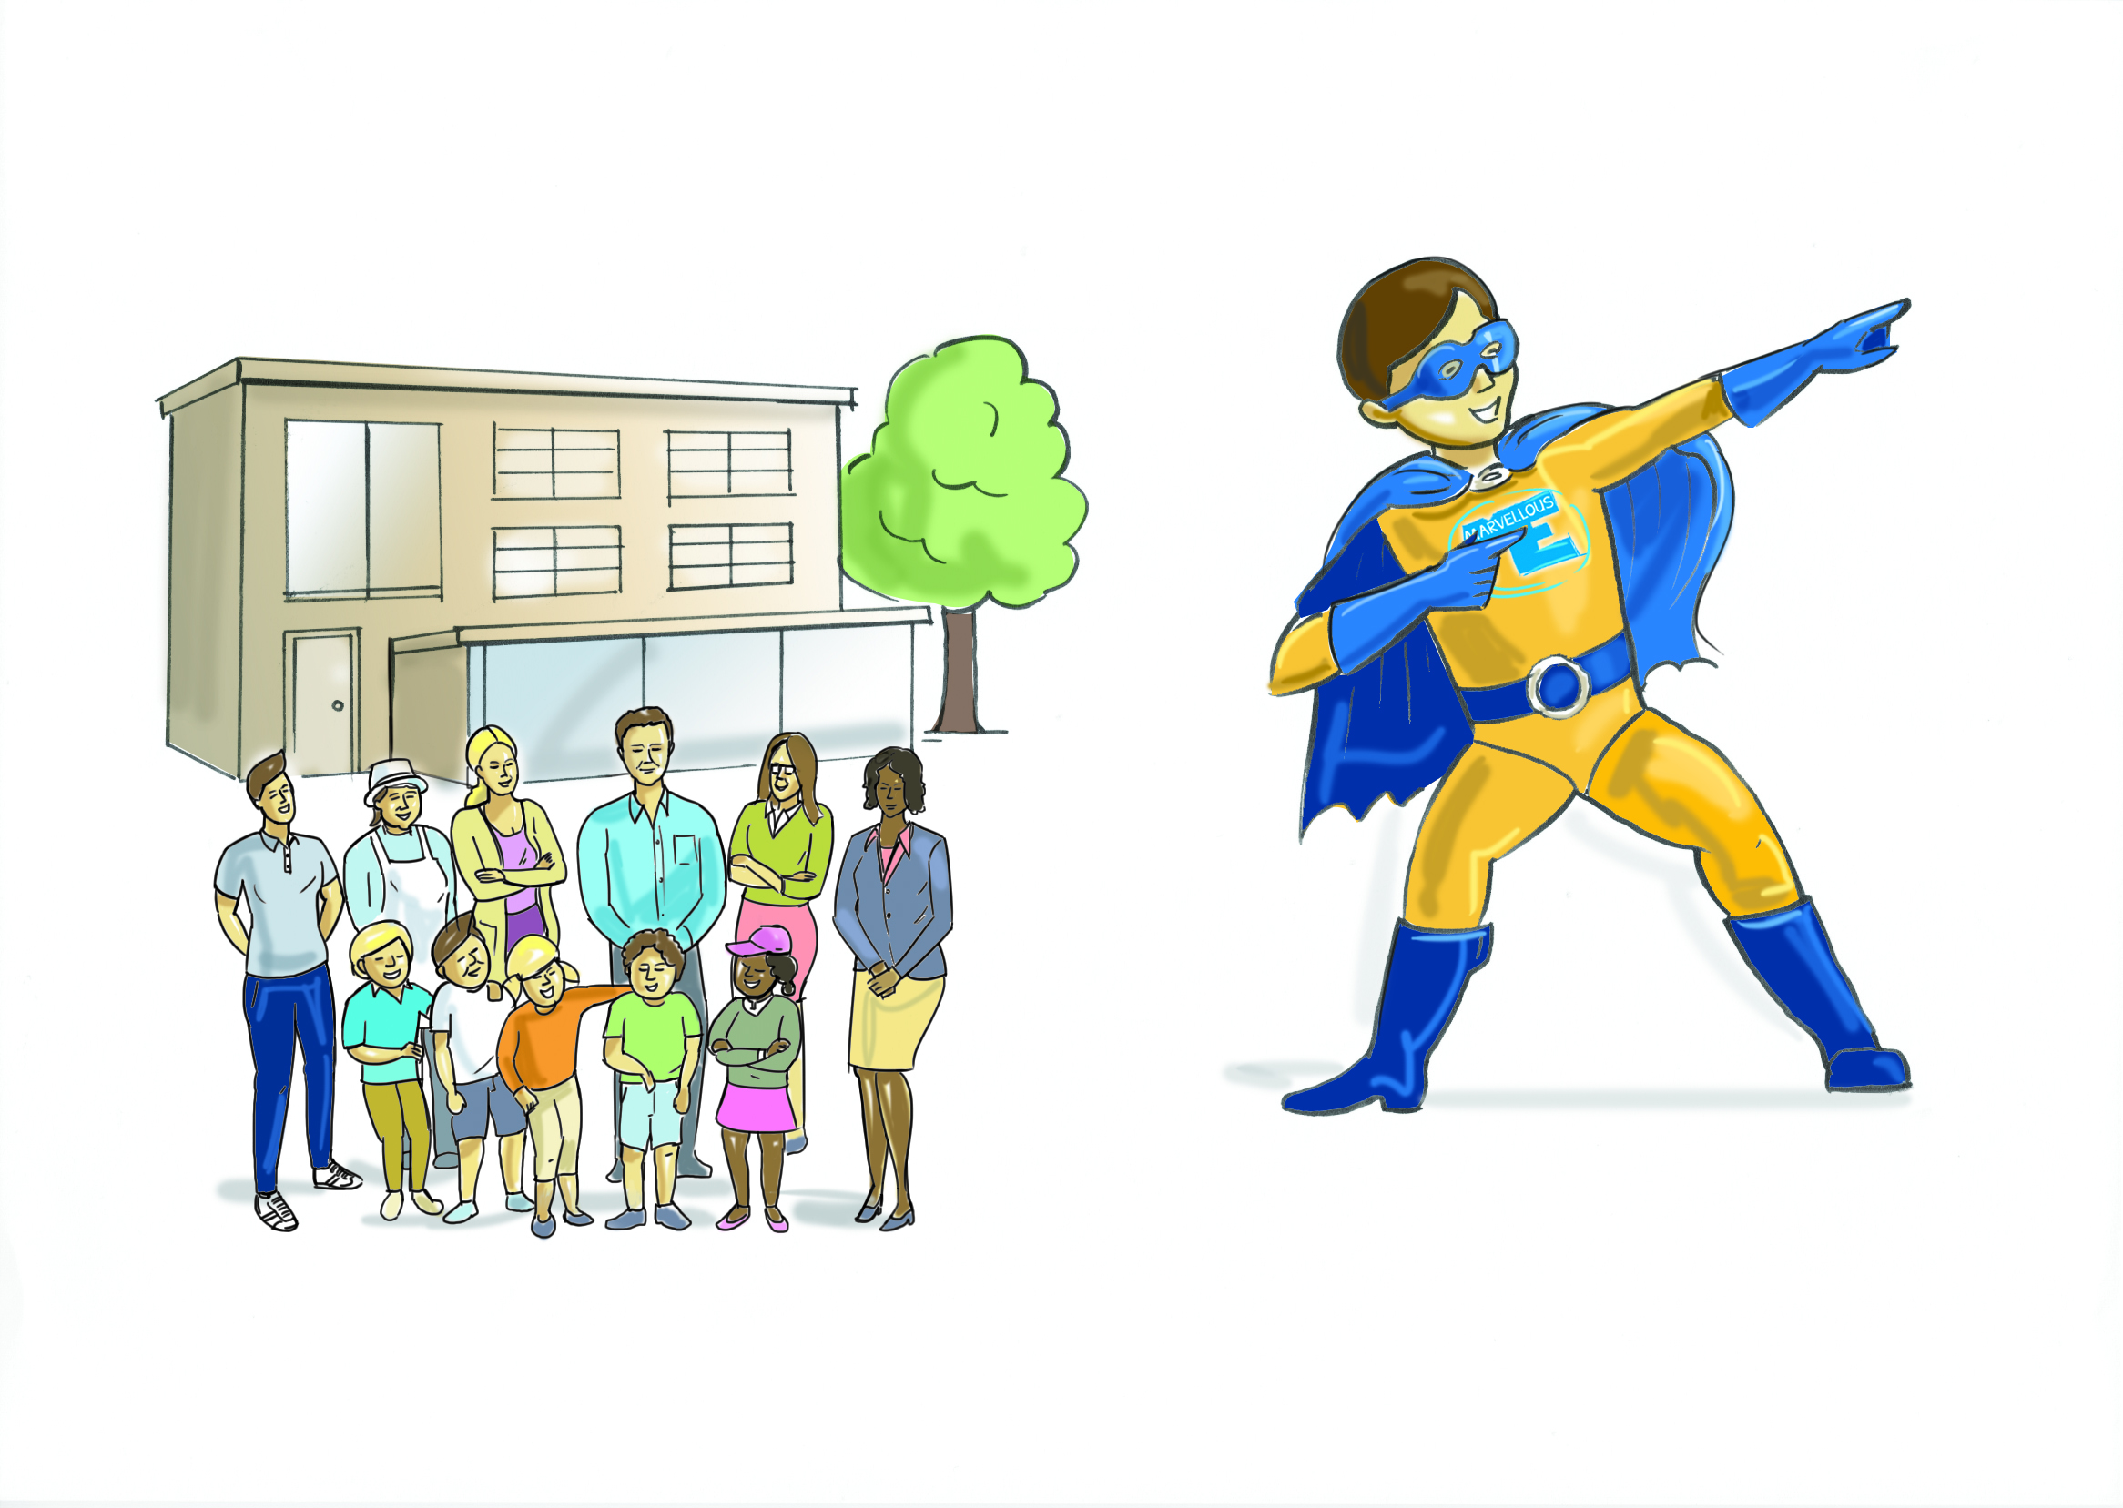
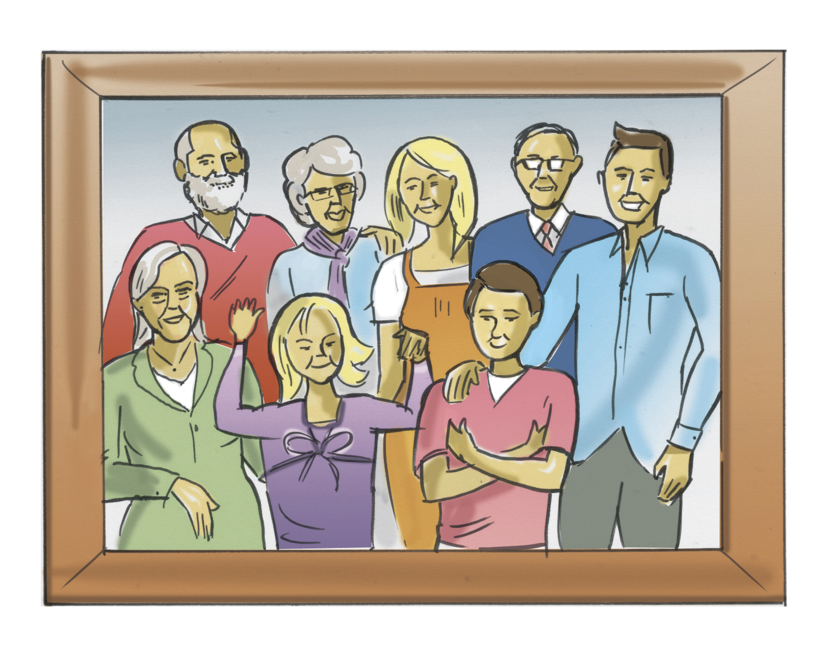
Why parents should join MarvellousMe
Whole school
Whole family
Whole child

Slide 2
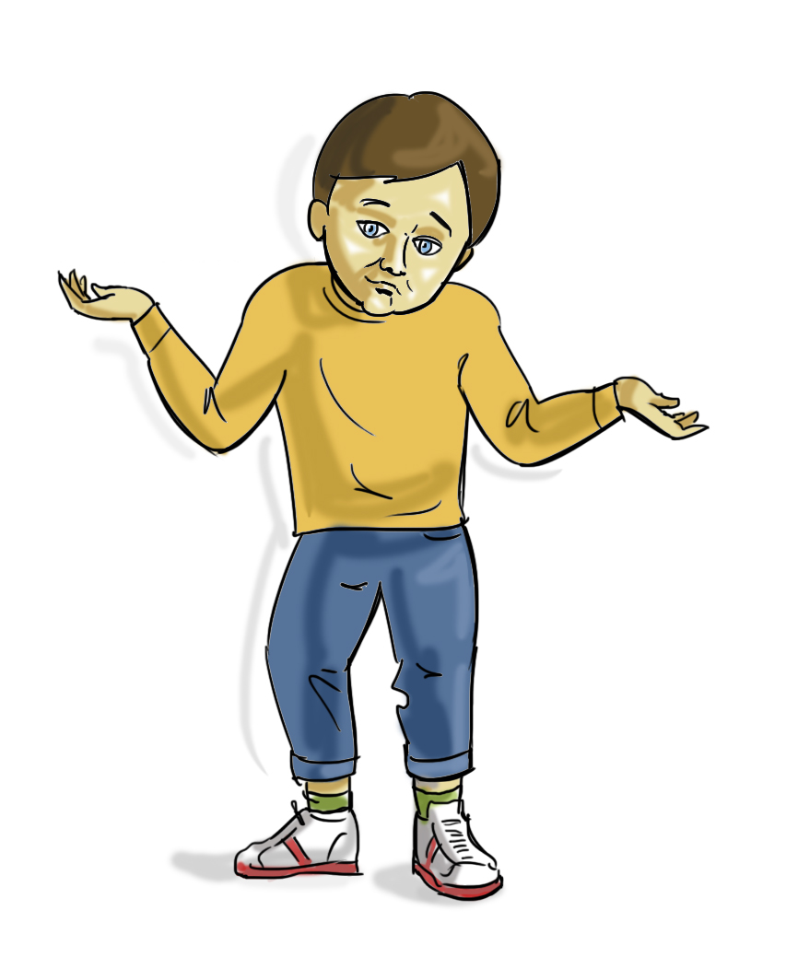

MarvellousMe will super charge family conversations about school and help your child do better.
Its exciting, simple and free.
What did you learn today?
What’s your award for?
Have you got any homework or messages?

Slide 3
Teachers will send you Activities sharing what your child is learning and
Badges to praise positive behaviour and celebrate their achievements.

Slide 4
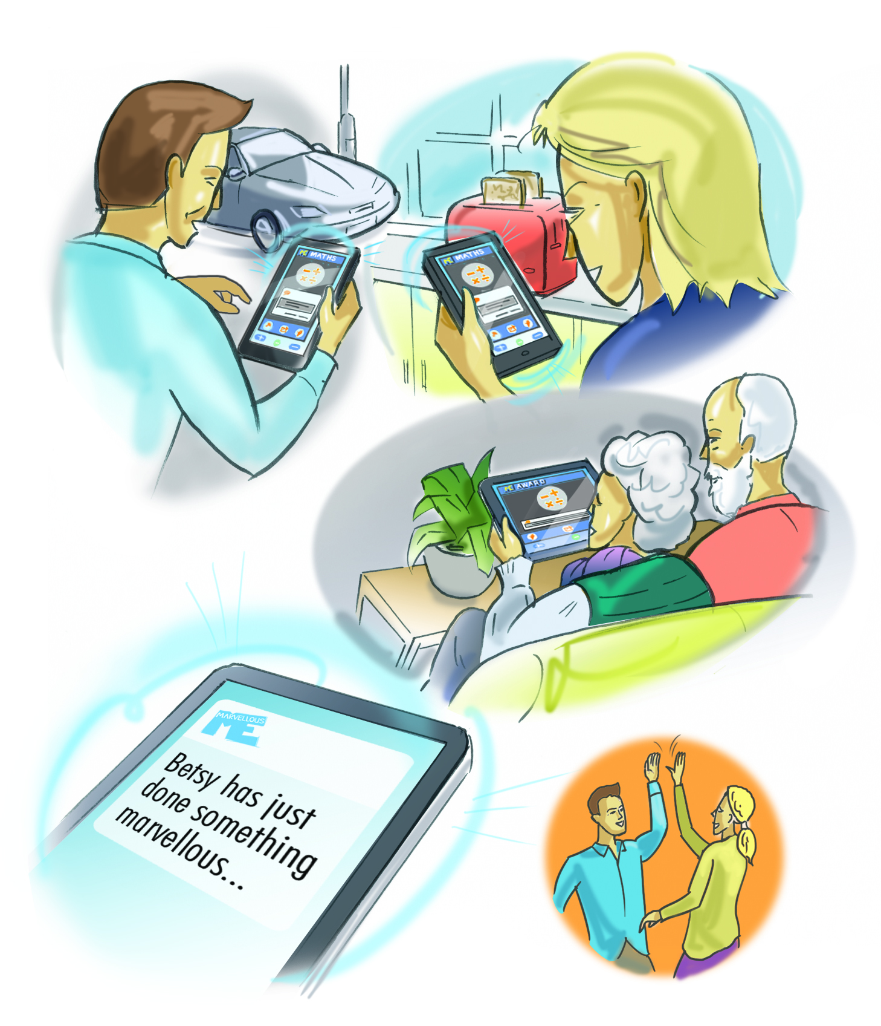
PING!
You will receive a instant and personal alert on your smartphone, tablet or PC, telling you that your child has done something marvellous.

Slide 5
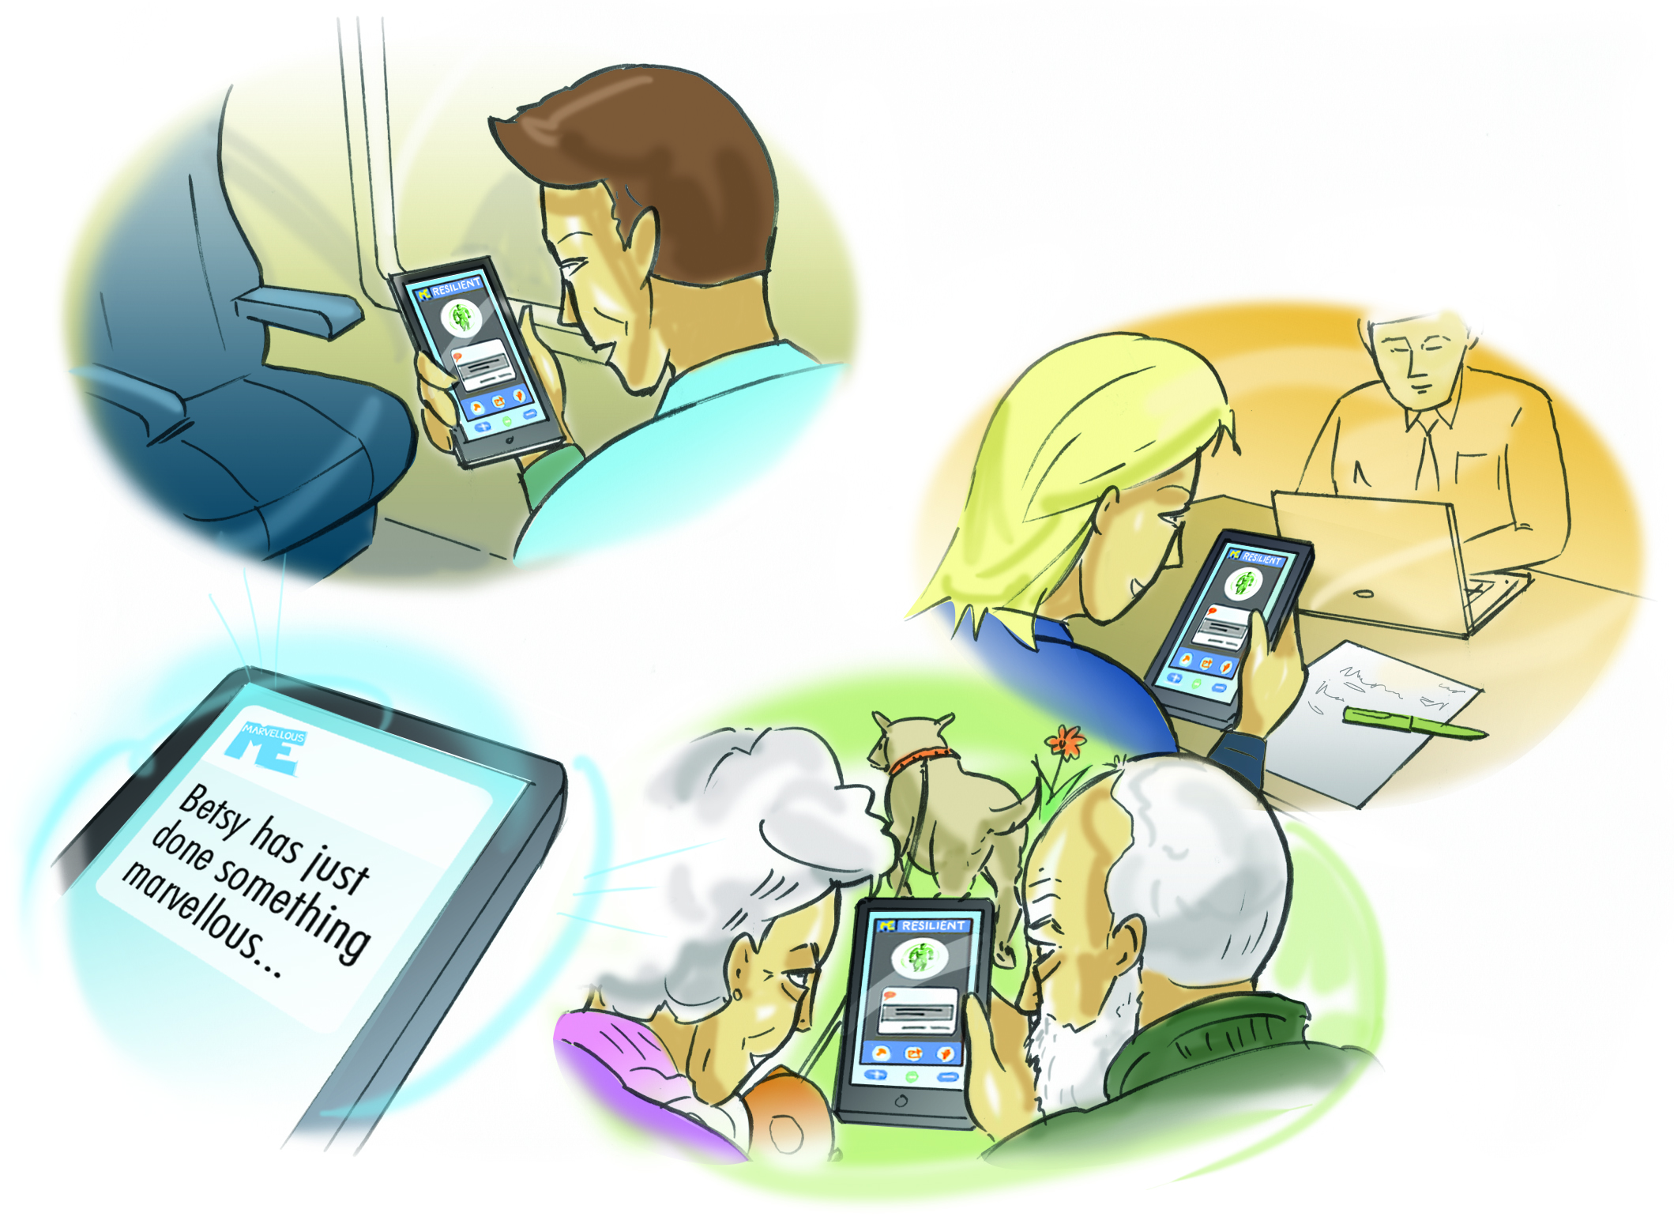
It’s perfect for split families and you can invite other family members so they too can share in the good news.
It’s guaranteed to make everyone smile, any time, any where.

Slide 6
MarvellousMes lead to more meaningful conversations at home with your child.
Children love to make their parents proud, plus they are happier and do better when their parents are involved in their school day.

Slide 7
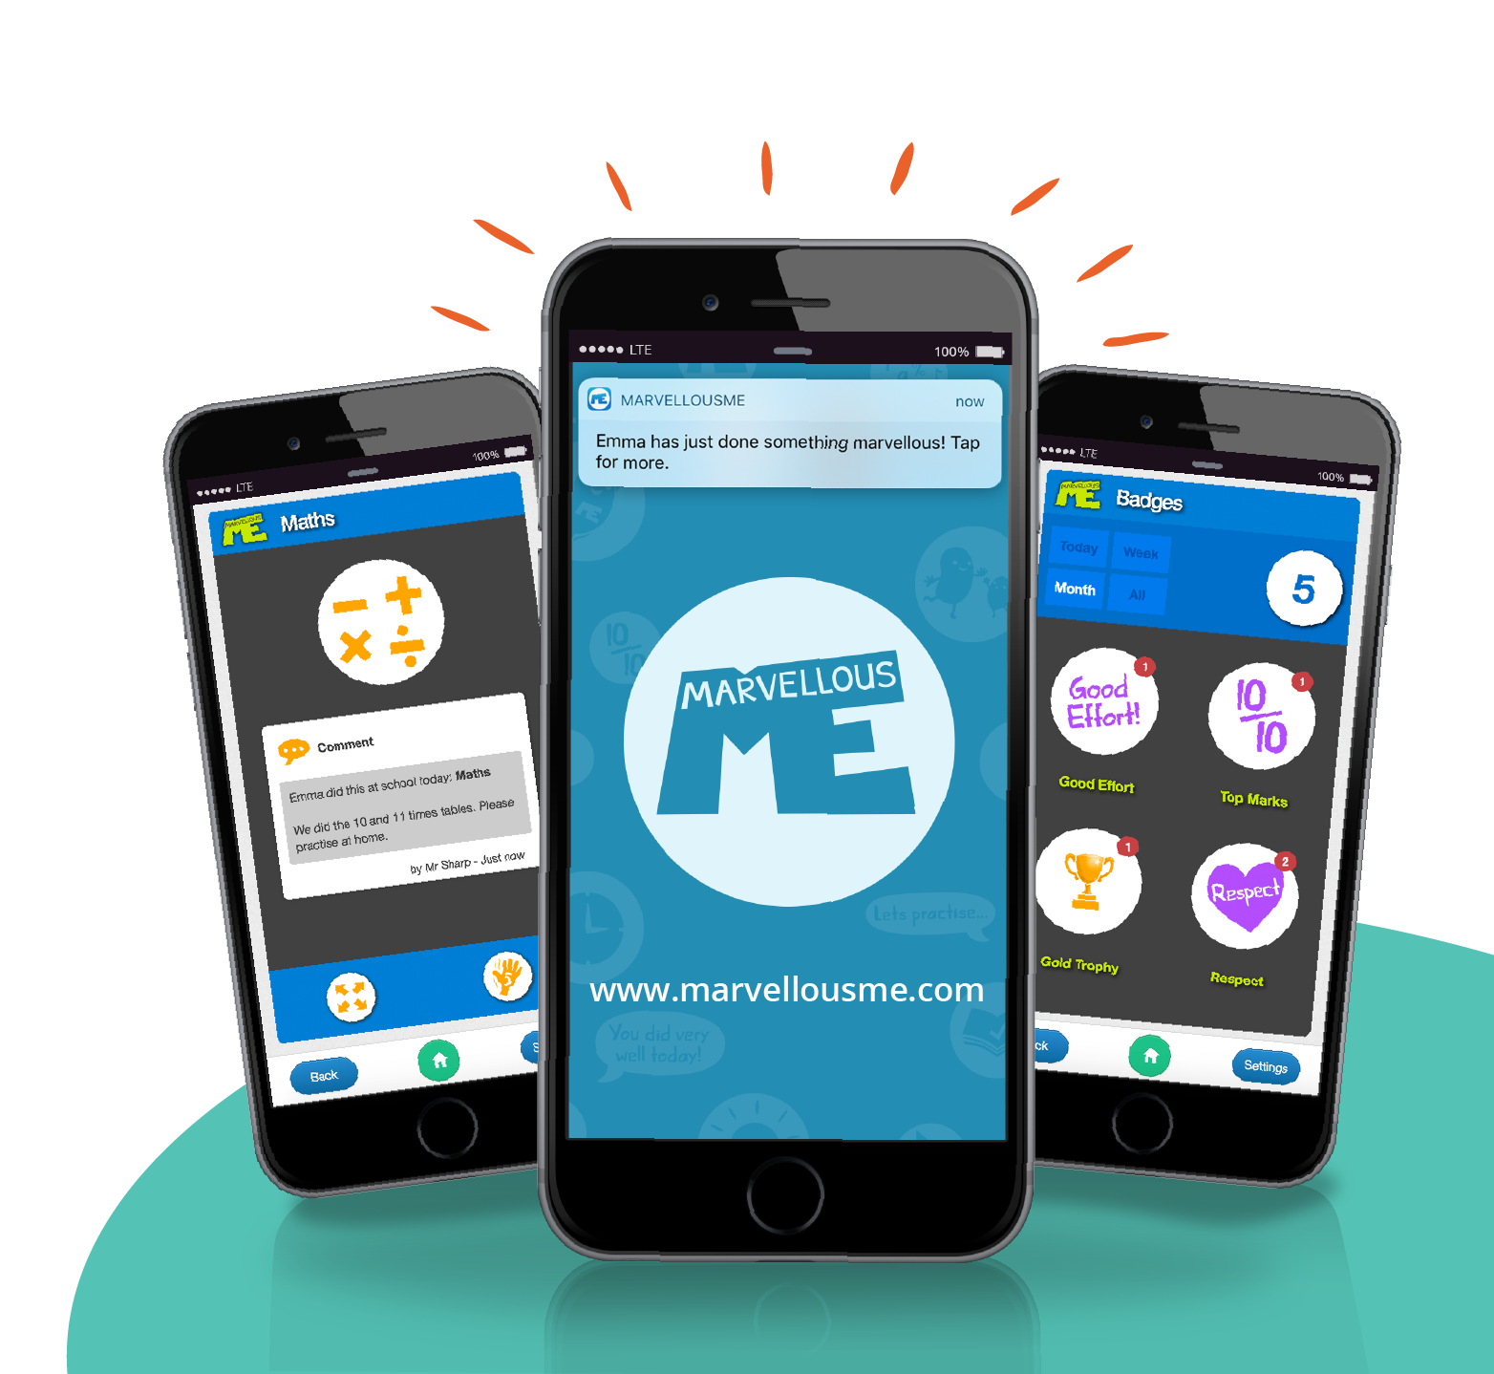
Become a Super Parent
Your child’s teacher or the school office can provide you with your child’s unique join letter containing instructions to quickly get you started.
Remember, MarvellousMe is free and simple to use - We know you will love it!

