Slide 1

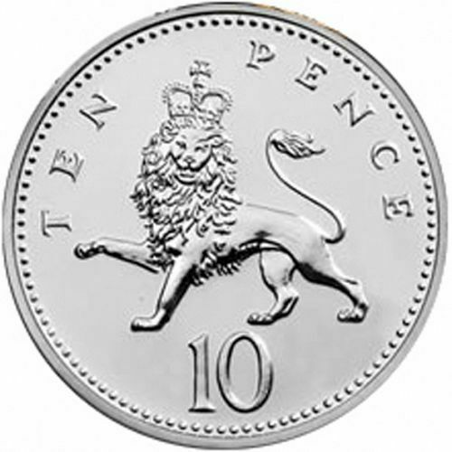
MarvellousMe Badge Design Template
Here’s an example MarvellousMe badge.
Can you design one to represent our school values/learning powers?
INSTRUCTIONS
Please draw your design in the empty circle. No touching the edges.
Please keep it simple, colourful and hi-impact. Imagine it being shrunk to the size of a 10 pence coin.
3. Give it to your teacher or the school office.

